Slide 1


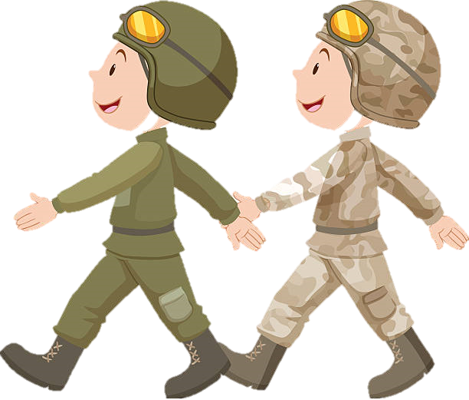



Wave, Wave, Wave the Flag
As we march around
Hold it high to show our pride
It must not touch the ground
Wave, Wave, Wave the Flag
Dear red, white and blue
Stars and Strips forever bright
America to you!

Slide 2

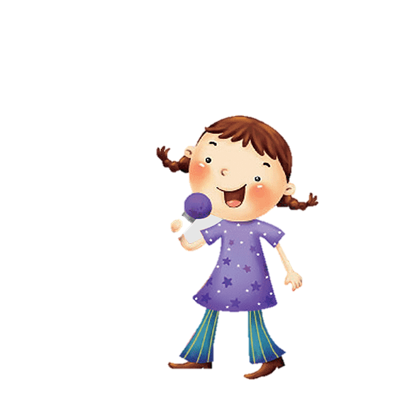
Red, White and Blue
Red, White and Blue (Echo)
I love you (Echo)
Red, White and Blue (Echo)
I love you (Echo)
Sing for our country
Sing for our country
Sing for our country
It’s brave and true

Slide 3
Red, White and Blue (Echo)
I love you (Echo)
Red, White and Blue (Echo)
I love you (Echo)
March for our country
March for our country
March for our country
It’s brave and true

Slide 4

Red, White and Blue (Echo)
I love you (Echo)
Red, White and Blue (Echo)
I love you (Echo)
Clap for our country
Clap for our country
Clap for our country
It’s brave and true

Slide 5
Red, White and Blue (Echo)
I love you (Echo)
Red, White and Blue (Echo)
I love you (Echo)
Sing for our country
March for our country
Clap for our country
We salute you!

Slide 6

Intro
March – 2-3-4-5-6-7-8 - x2
Feeling good!
Motivated!
A
All Right!
Dedicated!
Marching!
Day & Night!
Hutt – 2 -3-4
Hutt – 2 -3-4
Atten-tion
Salute
Notes:
A and B
A - Students sing with movement of SX
B - Student improvises for students to move (up and down)

Slide 7
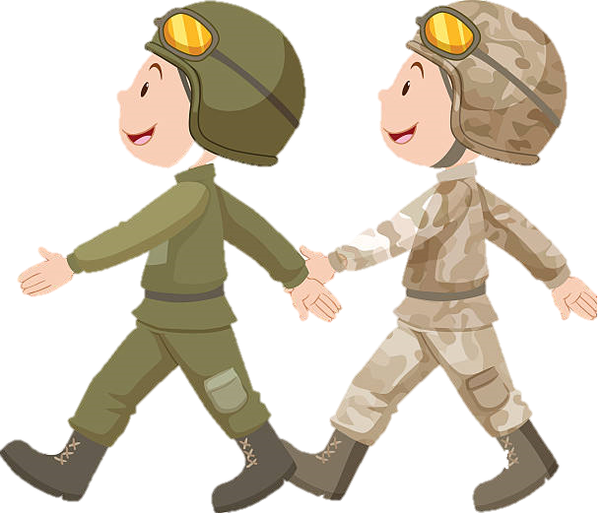
I’ve been doing what I’ve been told
This marching is getting old!
Feet Hurt!
Time for Bed!
B
Sound Off – 1- 2 – Echo!
Notes:
A and B
A - Students sing with movement of SX
B - Student improvises for students to move (up and down)

Slide 8
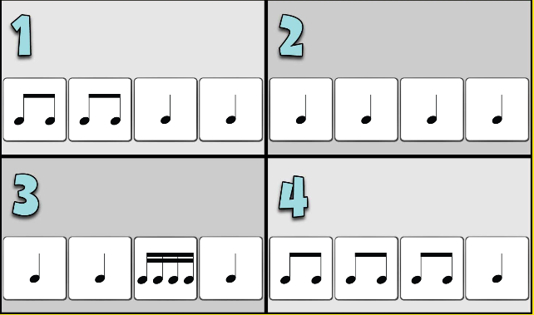

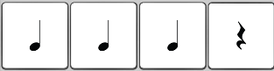

1
2
3
4
5
6
Notes:
A and B
A - Students sing with movement of SX
B - Student improvises for students to move (up and down)

Slide 9
Marching on this Picnic Day
Thankful for you all today!
Atten-tion
Salute
Notes:
A and B
A - Students sing with movement of SX
B - Student improvises for students to move (up and down)

Slide 10
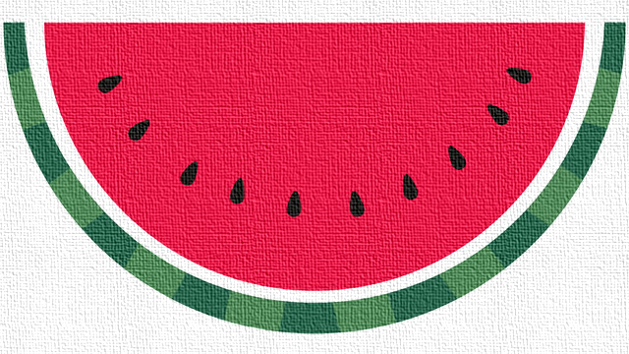
Watermelon, Watermelon yummy
Watermelon, Watermelon yummy
I've got watermelon in my tummy
Coolly crispy when its sunny
Watermelon, Watermelon yummy

Slide 11
1 - 2 - 3
Save some for me
4 - 5 - 6
Your fingers might get sticky
7- 8 - 9
The taste divine
Watermelon, Watermelon get in my belly
Watermelon, Watermelon get in my belly

Slide 12
Watermelon, Watermelon yummy
Watermelon, Watermelon yummy
I've got watermelon in my tummy
Coolly crispy when its sunny
Watermelon, Watermelon yummy

Slide 13
Pink
Watermelon
Cool
Watermelon
Juicy
Watermelon
Get in my belly
Fresh
Watermelon
Sweet
Watermelon
Yummy
Watermelon
Get in my belly

Slide 14
Watermelon, Watermelon yummy
Watermelon, Watermelon yummy
I've got watermelon in my tummy
Coolly crispy when its sunny
Watermelon, Watermelon yummy

Slide 15
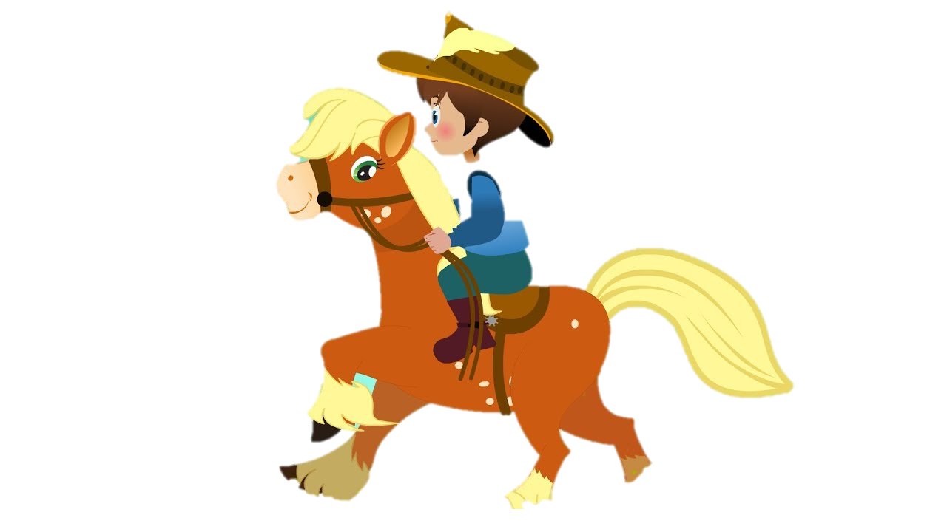
Yankee Doodle
Yankee Doodle went to town,
riding on a pony
Stuck a feather in his cap
and called it macaroni
Yankee Doodle keep it up,
Yankee Doodle dandy,
Mind the music and the step
and with the girls be dandy

Slide 16

Father and I went down to camp
along with Captain Gooding
there we saw the men and boys,
as thick as hasty pudding
Yankee Doodle keep it up,
Yankee Doodle dandy,
Mind the music and the step
and with the girls be dandy

Slide 17
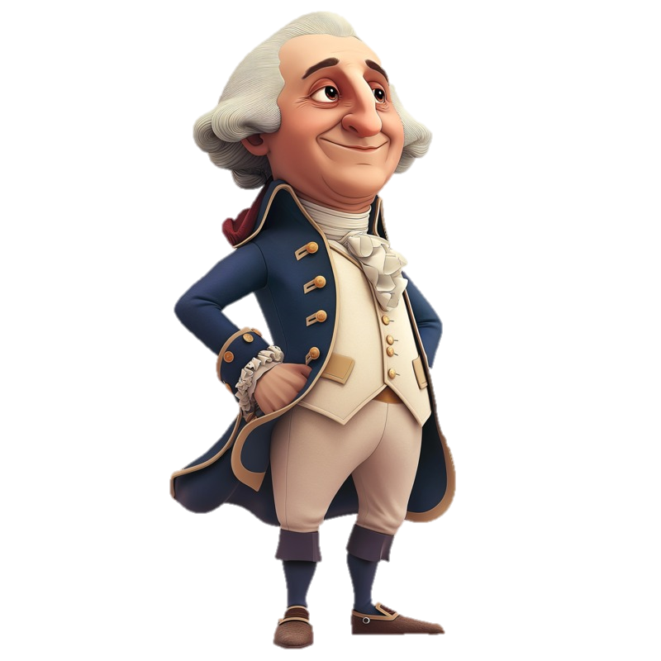
There was Captain Washington,
upon a slapping stallion
A-giving orders to his men,
I guess there was a million
Yankee Doodle keep it up,
Yankee Doodle dandy,
Mind the music and the step
and with the girls be dandy

